Slide 1
Office of <EM, NNSA, SC>
<Project Name>
Critical Decision-2
Approve Performance Baseline
<ESAAB> or <PMRC> Brief
Presented by: <Name of Briefer> <Title>
<Date of Brief>

Slide 2
Briefing Outline
Background and Baseline Summary
Rendering (Optional)
Baseline Scope
Baseline Cost Estimate
Baseline Schedule
Funding Profile
Project Organization and Project Execution Plan
Major Risks, EIR / ICE Results and PMRC Issues
CD-2 Prerequisites
PMRC Issues (If applicable)
Conclusions and Recommendations

Slide 3
Background
  CD-0, Mission Need, approved <Date approved>
    One line mission need statement
  CD-1, Alternative Selection and Cost Range, approved <Date approved>
    Describe selected alternative
    Project Location: ?
    Cost Range: ?
    Projected completion date: ?
  Summary progress since CD-1
    Bullets of significant actions completed
    Only include the projects Top 5 accomplishments

Slide 4
Baseline Summary
    TODAY’S DECISION: Critical Decision-2
    Approval of Performance Baseline
  KPPs: List of Key Performance Parameters
  Scope: High level scope statement
  Cost: $ ?? M TPC
  Schedule: Month/year date (CD-4)

Slide 5
Project Rendering
Optional
Picture/rendering of the Project
Placed Here

Slide 6
Baseline Cost Estimate
Cost Description |  | ($M)
Total Project Cost (TPC)
Federal Controlled | DOE Contingency
 | Other Government Direct Costs
 | Profit/Fee Opportunity
In Contract | Performance Measurement Baseline (PMB)
 | Management Reserve

Slide 7
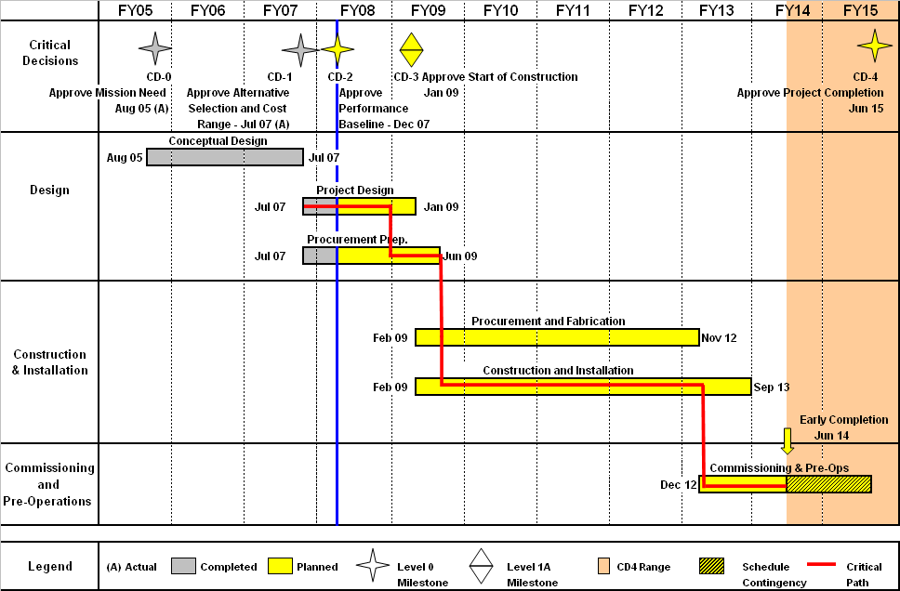
Baseline Schedule
Generate a complete high level schedule for your project with critical path and schedule contingency identified -- use this format/layout.
ESAAB Briefing Date

Slide 8
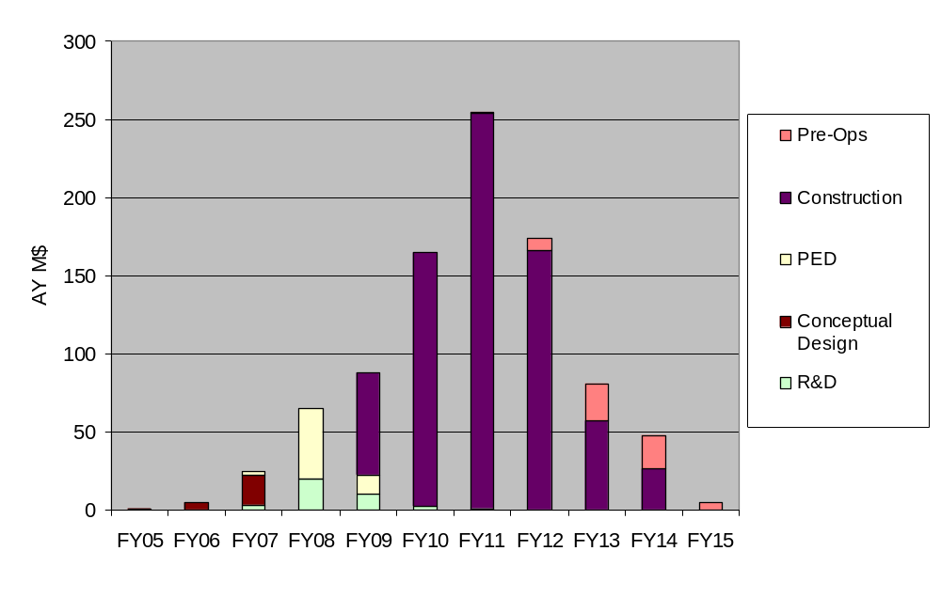
Funding Profile
(Project Name) Funding Profile ($M)
Fiscal Year | FY05 | FY06 | FY07 | FY08 | FY09 | FY10 | FY11 | FY12 | FY13 | FY14 | FY15 | Total
R&D |  |  | 3 | 20 | 10 | 2 | 1 |  |  |  |  | 36
Conceptual Design | 1 | 5 | 19 |  |  |  |  |  |  |  |  | 25
PED |  |  | 3 | 45 | 12 |  |  |  |  |  |  | 60
Construction |  |  |  |  | 66 | 163 | 253 | 166 | 57 | 26 |  | 731
Pre-Ops |  |  |  |  |  |  | 1 | 8 | 24 | 22 | 5 | 60
Total | 1 | 5 | 25 | 65 | 88 | 165 | 255 | 174 | 81 | 48 | 5 | 912

Slide 9

Project Organization
Deputy Secretary of Energy
(Chief Executive for Project Management)
Dr. Elizabeth Sherwood-Randall
Deputy Under Secretary for Performance and Management
Mr. David Klaus
Place an Organization Chart here that clearly indicates the lines of communication / responsibility from the Chief Executive (if a Major System Project ) to the Project Management Executive; all the way down to the project site / team Owner and FPD.
Indicate the names and contact number for each person on the chart.
Assistant Secretary for Environmental Management (Acting)
(Project Management Executive / Project Owner)
Mr. Mark Whitney
Headquarters
Deputy Assistant Secretary for Tank Waste
Mr. Ken Picha
ORP Site
Manager, Office of River Protection
Mr. Kevin Smith
One-System Manager, Office of River Protection
(Project Mentor)
Mr. Ben Harp
FPD Level IV
Contracting Officer
Mr. Wade Hader
CO Level 3
Federal Project Director
Mr. Steve Pfaff
FPD Level I
Integrated Project Team
Chartered
Note: Org chart should show at a minimum - PME, Owner, Respective Chain of Command and FPD

Slide 10
Project Execution Plan
Key Tailoring Strategies:
Identify any unique project strategies
Key Performance Parameters (KPPs) at CD-4:
List Project KPPs
What Keeps Me Up At Night About This Project:
List your Major Project Concerns

Slide 11
Major Risks
<Identify the major risks anticipated on the project>

Slide 12
Results of Project Reviews Completed
EIR/IPR/Red Team/etc. completed on <Date>
EIR/IPR/etc. Results: “X” Major Findings, “X” Findings
  Major Finding 1: State finding here
        Resolved: State project’s action(s) to close the finding
  Major Finding 2: State finding here
        Resolved: State project’s action(s) to close the finding
  Findings: General statement on identified findings and actions taken
ICE/ICR completed on <Date>
  ICE/ICR Suggested Cost and Schedule:
  TPC of $ <XX.X> M and a <Date> CD-4 date

Slide 13
PMRC Issues
<Identify those significant issues (as appropriate) that the PMRC should be made aware of>

Slide 14
CD-2 Prerequisites
☑ Performance Baseline including Key Performance Parameters
☑ Project Execution Plan
☑ Earned Value Management System
☑ Performance Baseline Validation EIR and IPR
☑ Acquisition Strategy
☑ Quality Assurance Program
☑ Preliminary Design
☑ Update the Project Data Sheet
☑ Design Review
☑ Preliminary Safety Design Report
☑ Technical Independent Project Review (nuclear facilities)
☑ Safety Design Strategy (nuclear facilities)
☑ Preliminary Safety Design Report (nuclear facilities)
☑ Hazard Analysis Report
☑ Site Security Plan updated
☑ Incorporated Sustainable Design
☑ Completed Environmental Reviews, FONSI issued
Tailor to your project as required by DOE O 413.3B, ensure all CD prerequisites are listed here. Place a check in each box that is complete!

Slide 15
Conclusions
Conclusions:
Sample “Conclusions” below…project develops their own.
Preliminary design is complete
Cost and schedule are reasonable with adequate contingencies
Management team and management systems are in place
Performance Baseline is ready for approval
No technology readiness issues remain
Design Maturity is at XX% complete
Funding is available/affordable

Slide 16
Recommendations
Recommendation:
Approve CD-2 for <Project name>
With following attributes: <Must Include:>
  KPPs:
  Scope:
  Cost/TPC:
  CD-4:

Slide 17
Back-Up Material as Needed

